Slide 1

PCWG Meeting #23 Overview
Friday, 01 February 2018
Hamburg, Germany

Slide 2
Agenda
2018 Roadmap Update
PCWG Vision and Mission

Slide 3
09.30 - 09.50 Introduction
09.30 - 09.40 Welcome, Demetrios Zigras, Nordex
09.40 - 09.50: Meeting Overview, Taylor Geer (DNV GL)
09.50 - 10.30: PCWG Activities/Roadmap Update: presentation of 2018 PCWG roadmap, Taylor Geer (DNV GL).
10.30 - 11.15: PCWG-Share-3 (Intelligence Sharing Initiative) Update, Peter Stuart (RES):
Update on analytical testing & implications for PCWG-Share-2 results.
Beta Testing & User Guide Update (Paul Housley SSE).
Preview of PCWG-Share-3.
Opportunity for "Enhanced Sharing".
11.15 - 11.30: Coffee Break
11.30 - 12.30: PCWG contribution to IEC 61400-15 discussion and planning Taylor Geer (DNV GL).
Lunch: 12.30 – 13.30
13.30-14.30 Afternoon Presentation Session
“New approached to power curve adjustments in WakeBlaster” – Philip Bradstock (ProPlanEn)
“Different implementations of REWS and TI correction” – Samuel Davoust (GE)
“Turbine performance practice and theory – updates from the leading edge” – Carl Ostridge (DNV GL)
“Calibrate to Power Concept”, Peter Stuart (RES).
14.30 - 14.45: Coffee Break
Afternoon Discussion/Break Out Session: 14.45-16:15
RSVP questions results
Breakout:
Ideas generation (in groups)
Initial re-group discussion
‘Effort vs Impact’ prioritisation (in groups)
Final Regroup discussion
Wrap Up & Next Meetings (16.15 – 16.45):
Virtual meeting for Share 3 results
Share 4
US meeting
2nd European meeting

Slide 4
PCWG Structure
Coordinator
Vice-Coordinator
Organisational Committee
Tool Development Subgroup
Tool Beta Testing Subgroup
Machine Learning Subgroup
Person | Org | Type
Taylor Geer | DNV GL | Consultant
Andy Clifton | WindFors | Academic
Inaki Lezaun | Gamesa | OEM
Paul Housley | SSE | Developer
Jason Dubois | EDF | Developer
Peter Stuart | RES | Developer
Jason Fields | NREL | Academic
Matt Colls | Prevailing | Consultant
Richard Whiting | Everoze | Consultant
Dan Bernadette | UL AWST | Consultant
Members

Slide 5
Agenda
2018 Roadmap Update
PCWG Vision and Mission

Slide 6
We’ve Always Known that Real World Wind Turbine Performance is NOT as Simple as Power=P(v, ρ)!
Extract from C.J. Christensen et al: ”Accuracy of power curve measurements”, Risø-M-2632, 1986...
”… The power curve is then seen as the relation between the power P(v) produced by this undisturbed wind v.
This definition is, however, of very doubtful value for a windmill in the natural wind. The main difficulty is that it assumes a smooth laminar flow of high degree of homogeneity and symmetry”
ρ = Air Density
P=P(v, ρ)
Power (P)
Wind Speed (v)
The PCWG aims to build industry consensus on how best to predict real world turbine performance and look beyond P=P(v, ρ). www.pcwg.org.

Slide 7
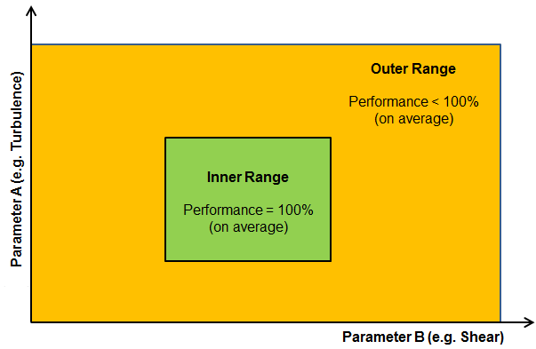
Reflecting the Real World: Inner-Outer Range Decomposition
Categories of Turbine Performance Corrections
PCWG Activities
Inner Range Performance
Adjustments to reflect the fact that even under warranted/ideal conditions performance may not be 100%
Outer Range
Outer Range Performance
Adjustments to reflect the fact that turbine performance may deviate from Inner Range behaviour in Outer Range Conditions
e.g. Low/High TI, Low/High Shear etc.
Inner Range
+ Other Performance Corrections
Icing, Blade Degradation, Sub-optimal performance etc.
Note: The PCWG Inner-Outer Range Proposal is Conceptual Decomposition, and does infer specific parameter ranges.

Slide 8
Reflecting the Real World: Average-Specific Decomposition
Categories of Turbine Performance Corrections
PCWG Activities
Average Performance
(Bulk) Adjustments to reflect the fact that on average (in all conditions) turbines may not meet their documented performance level
Remove Bias
Conditions Specific Performance
Adjustments to reflect the fact that turbine performance may deviate from average performance in ‘non-average’ Conditions
e.g. Low/High TI, Low/High Shear etc.
Remove Uncertainty
Improve Project Design
→ Reduced:
£/MWh
$/MWh
€/MWh
+ Other Performance Corrections
Icing, Blade Degradation, Sub-optimal performance etc.

Slide 9
Classification of PCWG Activities by Component
Note: whilst the two decompositions are subtly different, they are broadly compatible with respect to the roadmap e.g. actions to further ‘Inner Range’ understanding, will generally further ‘Average Performance’ understanding.
The type of PCWG activates differs strongly depending on the problem component
The PCWG is seeking to define an assessment framework to define how to make best use of historic power performance tests when predicting future inner/average performance.
Inner Range Performance
Average Performance
The PCWG is attempting to evaluate quantitative methods for predicting Outer/ Specific performance via the PCWG Intelligence Sharing Initiative (PCWG-Share-X)
Outer Range Performance
Conditions Specific Performance

Slide 10

Reflecting the Real World: Inner Range / Average Performance
Extract from ‘High Resolution Turbine-Specific Matrix’, Carl Ostridge DNV GL,
Colorado PCWG Meeting, 10 August 2016, download from www.pcwg.org.

Slide 11
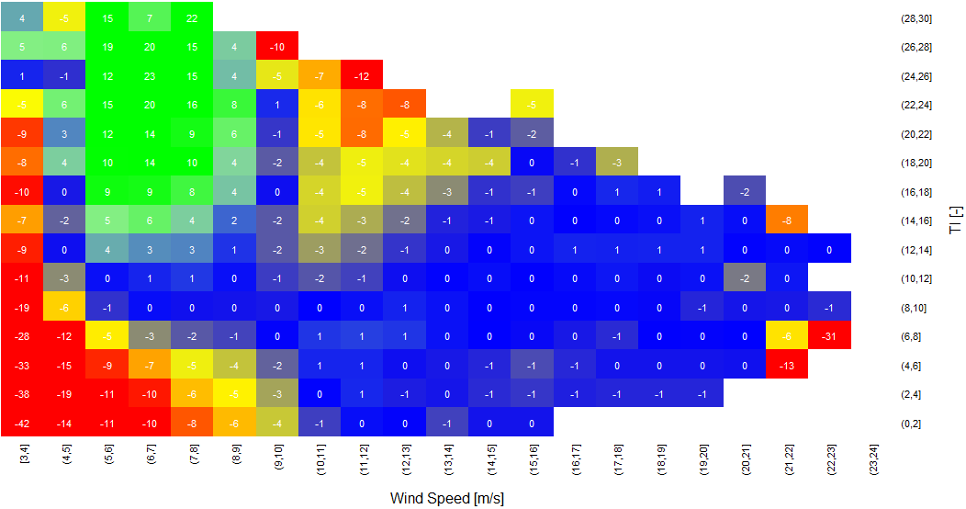
Reflecting the Real World: Outer Range Performance
Inner Range Performance
Outer Range Deviations (Observed – Base)
Colour = % Observed Power Deviation
(Observed - Base)
High TI & High V
Negative Deviation
High TI & Low V
Positive Deviation
Power (P)
P=P(v, ρ)
Turbulence Intensity [%]
Low TI & Low V
Negative Deviation
Wind Speed (v)
Wind Speed [m/s]

Slide 12
Agenda
2018 Roadmap Update
PCWG Vision and Mission

Slide 13
PCWG 2018 Roadmap
Roadmap Page 1/4
OUTCOME
1. Inner/Average Performance
Define best practice guidelines for stakeholder data exchange and analysis to establish inner/average performance
Evidence Pathway for Inner/Average Performance
→ Reduced Investor Risk
2. Outer/Specific Performance
Objectively determine/refine the best methods for modelling outer/specific performance using the PCWG-Share-X Platform
50% reduction in outer/specific modelling uncertainty, contribute to IEC 61400-15
→ Reduced Investor Risk
3. Enabling Activities
Publically available worked Examples
PCWG Analysis Tool Development
The right tools & industry understanding to deliver items 1 & 2
NOW
End of 2018

Slide 14
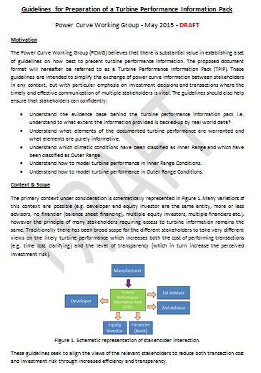
PCWG 2018 Roadmap
Roadmap Page 2/4
1. Inner/Average Performance
Define best practice guidelines for stakeholder data exchange and analysis to establish inner/average performance (based on real world industry practice)
2018 - Timeline
Draft Guidelines Document (based on a overhaul of existing DRAFT ‘guidelines for preparation of a turbine information pack’ document).
Aug
Sep
Feedback
Oct
Updated Draft Document
Nov
Final Feedback
Dec
Publication on PCWG Website

Slide 15
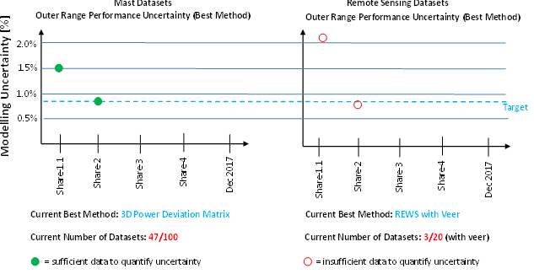
Roadmap Page 3/4
Measuring Progress
2. Outer/Specific Performance
2018 - Timeline
PCWG-Share-3
Feb
Jun
PCWG-Share-4
Sep
Provide input to IEC 61400-15

Slide 16
PCWG 2018 Roadmap
Roadmap Page 4/4
3. Enabling Activities
Publically Available Worked Examples
Further Worked Examples to support PCWG-Share-X and ensure numeric integrity.
Avoid further work examples & round robins not directly related to PCWG-Share-X (focus and bandwidth)
PCWG Analysis Tool Development
Implementation of New Methods
Improved Testing and worked examples
Improved Beta Testing (Beta Testing Sub Group) – Led by Paul Housley (SSE)
Improved Documentation (Beta Testing Sub Group) - Available for PCWG-Share-3
Machine Learning
Sub-group meetings and discussions
Creation of Machine Learning Web Service for PCWG-Share-4
Publish Summary of PCWG Activities & Outcomes (on PCWG Website)

Slide 17
Summary
Focus activities of group:
Don’t try and do too much.
Focus on delivering tangible input to IEC 61400-15 (by Q3)
PCWG-Share-X
Leverage PCWG-Share-X to achieve 1)
Implement lessons learnt and ensure tool is comprehensively numerically and usability tested prior to start each sharing iteration (don’t rush!)
Best practice guidelines
Distil best of current industry practice

Slide 18
Questions/Discussion

